Slide 1
Banking Loan Prediction
Group 2

Slide 2
Problem Statement
Scope & Limitations
Data Information
Bank wants to increase customer acquisition (leads) through digital channels (emails, online campaigns, etc) and have a higher lead conversion ratio
Identifying potential leads by checking loan approval rate
Partial data set for customers loan history
We aim to predict the probability of customers conversion i.e. Loan Approval
Automated identification of customer segment through given database
Business resources utilized well
Could be other ways to segment the customers and increase the lead conversion ratio
Missing information and erroneous data
No well defined Data Dictionary
Shape : (69713, 22)
Source: https://www.kaggle.com/arashnic/banking-loan-prediction
Notes:
Anupriya

Slide 3
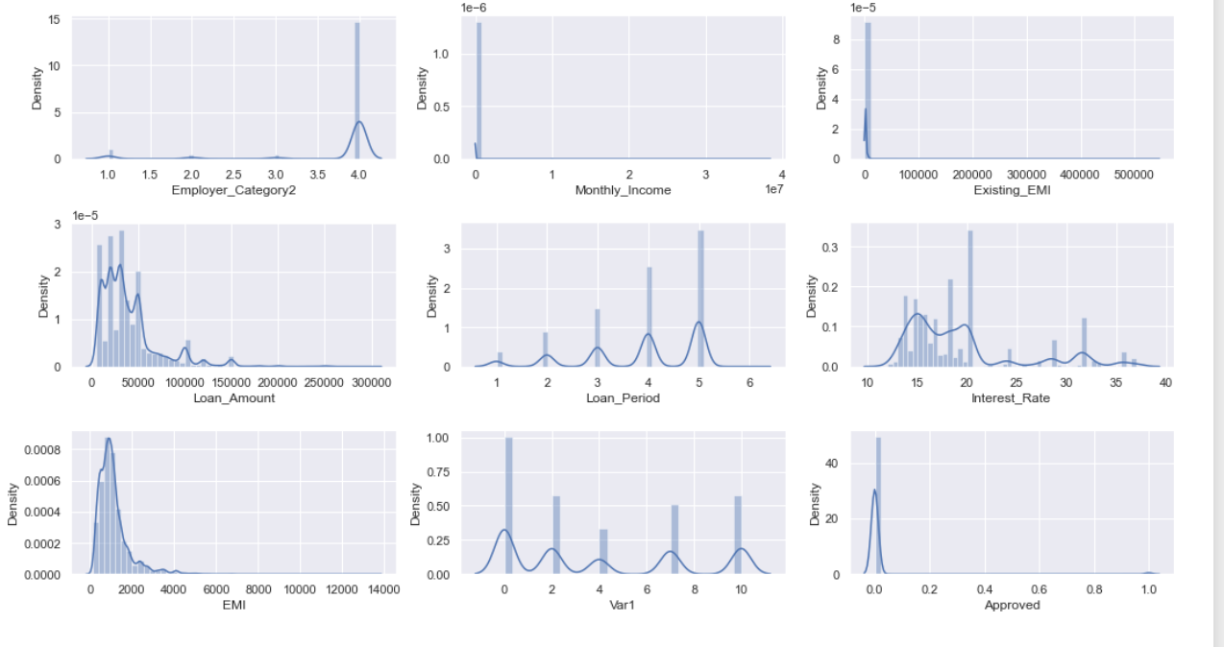
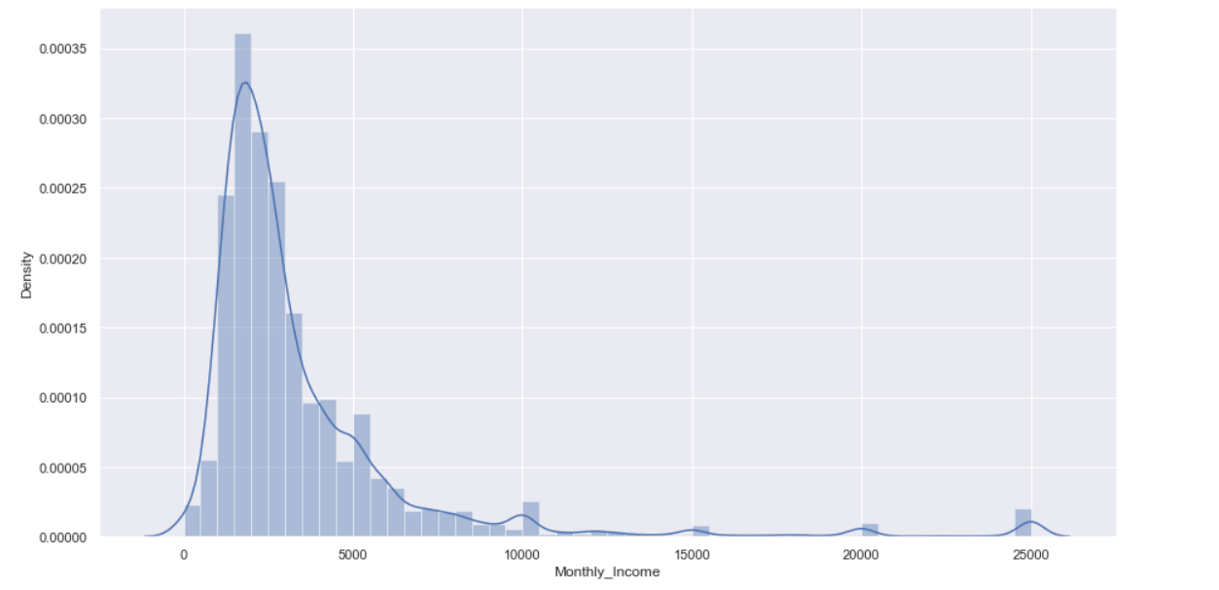
Univariate Analysis
Monthly Income
Monthly income is highly right skewed due to applicants with very high monthly income.
Existing_EMI
Most of the applicants has no existing EMI.
Employer_Category2
Most of the applicants has employee category as 4.
Loan_amount
Loan amount is multimodal
It appears to be right skewed.
Maximum of the applicant have applied for a loan below 100000.
Loan_period
Applicants have requested loan for a tenure of 1,2,3, 4 or 5 years ,with 5 years being the choice of most of the applicants.
This is also multimodal.
Interest Rate
No particular pattern seen.
Max density can be seen between 10 - 25.
EMI
Emi is right skewed.
Maximum applicants’ emi is coming out to be somewhere between 100-2000
Employer Category2
Monthly Income
Existing_EMI
Loan_amount
Loan_period
Interest Rate
EMI
Notes:
Prakhar
Monthly Income, Existing EMI, Loan Amt

Slide 4
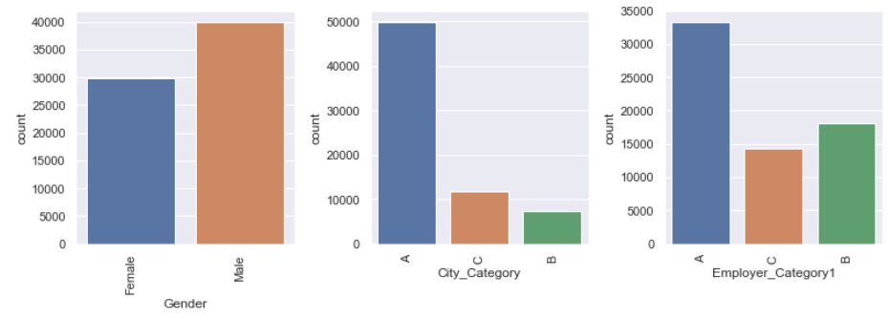
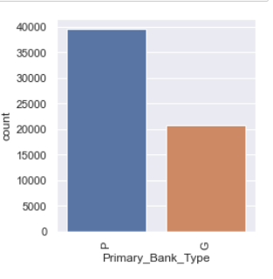
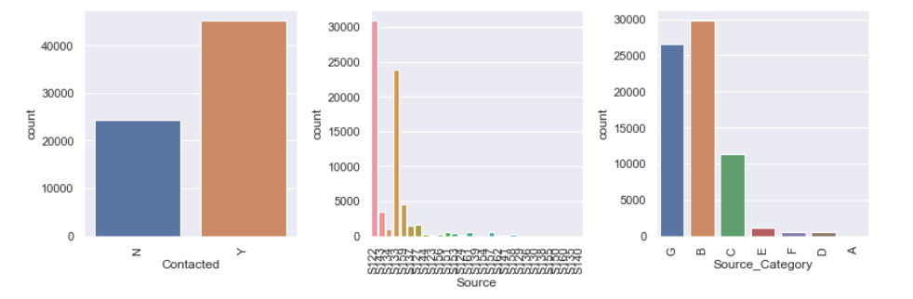
Univariate Analysis
Gender
More than 50% of the leads are Males.
City Category
Most of the leads fall in city category:A followed by C.
Employer Category 1
Most of the leads have employer category as A followed by B.
Primary Bank Type
As per our understanding the two categories (P and G) can be interpreted as PRIVATE and GOVERNMENT
Approx more than 60% of the leads are having their primary bank type as PRIVATE.
Contacted
Approx more than 55% of the leads have been contacted by the bank.
Source Category
Most of the leads are in source category B, G, C respectively as per increasing density of leads.
Gender
City Category
Employer Category1
Contacted
Primary Bank Type
Source Category
Notes:
Rijul

Slide 5
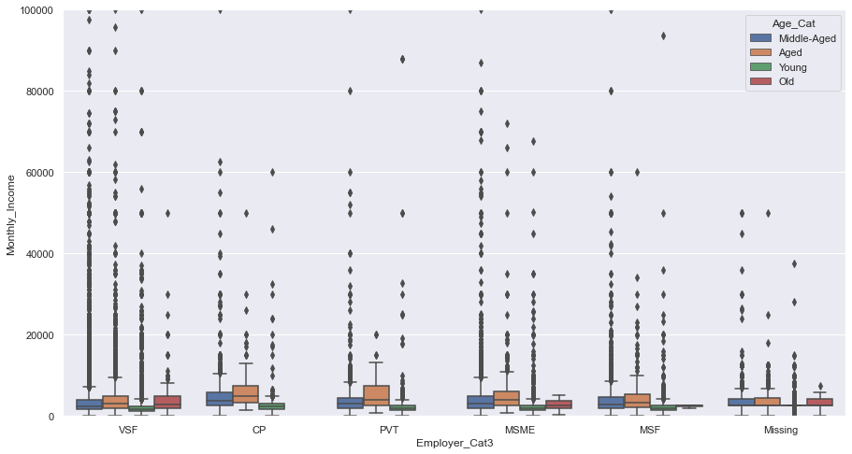
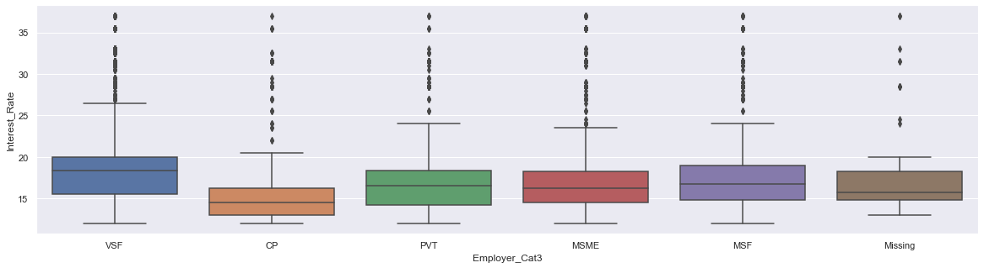
Bivariate
and
Multivariate
Notes:
Ayush & Deepansh

Slide 6
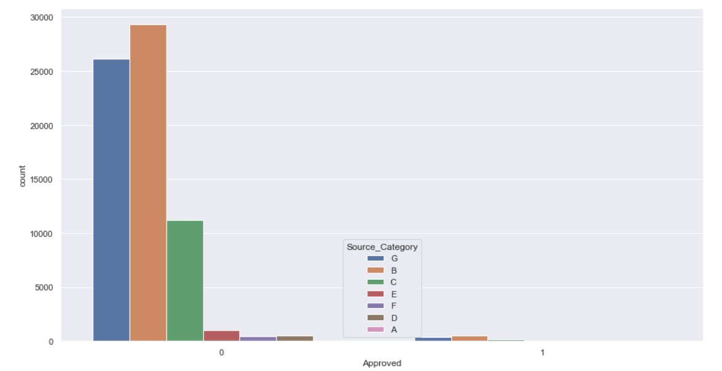
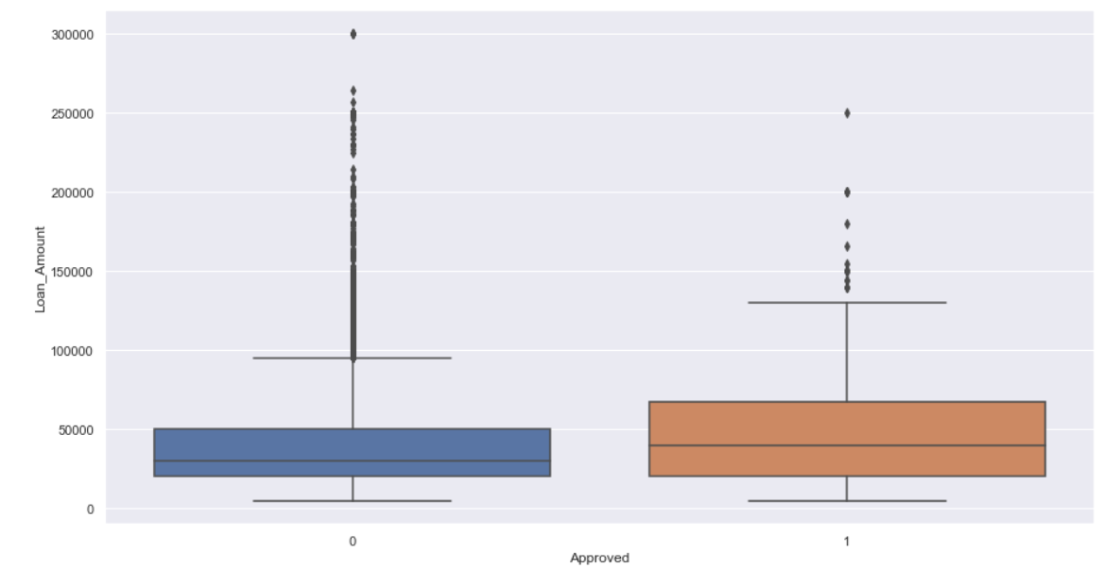
Employer_Cat3 vs Monthly_Income
Old People are having on an average less income across Employer Categories.
Employer_Cat3 vs Interest
Here we can see that the highest Interest has been charged to the VSF companies and the cheaper to CP companies.
Count vs Approved
Most leads are converted from Source Category B,G and C.
There are no approvals from category A and D.
Loan_Amt vs Approved
People who have high loan amount has more chances for the loan approval.
Notes:
Ayush & Deepansh

Slide 7
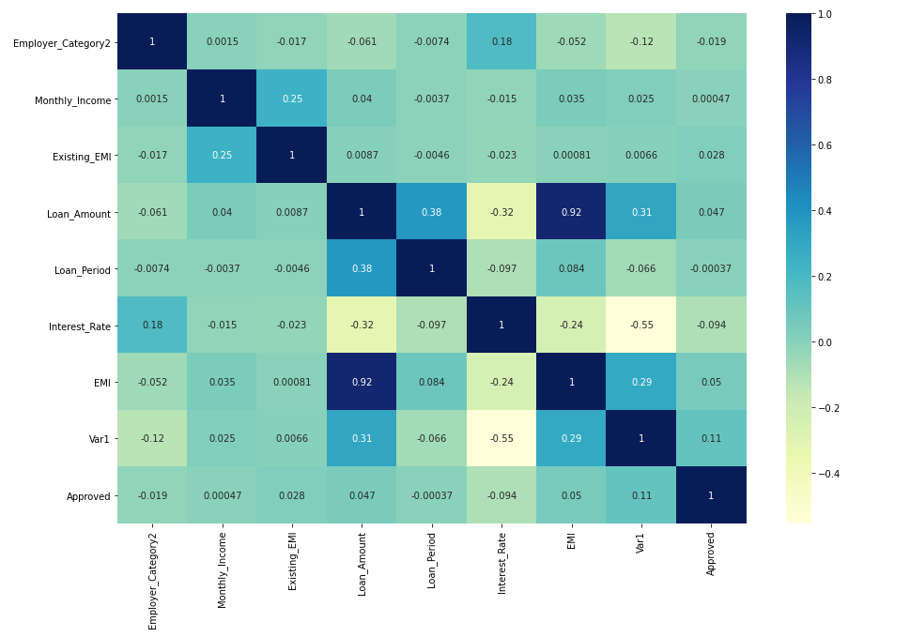
Correlation among variables
Emi and loan amount have strong positive correlation
var1 and interest rate have negative correlation

Slide 8
Key Insights from EDA
Very high monthly income of 0.01 customers could be erroneous data
City Categories A, B, C- Income of individuals
Approvals were highest during quarter 4 of the financial year even though least applications
Var1- anonymous category made by the bank : Credit Score
Loans Approved- Average Monthly Income high
Most leads from Source Categories B, G and C
Notes:
Anupriya

Slide 9
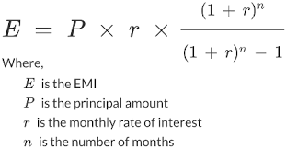
Feature Engineering
Age_category ( using DOB and Lead creation month)
Monthly income to EMI ratio.(using EMI as sum of expected and existing)
Loan to income ratio(dividing the loan amount by total income in the loan tenure)
EMI (calculated missing values in EMI using the formula mentioned
Created quarters from lead creation month .
Employer category 3 (by bifurcating employers into VS,S,M,L,VL,Missing basis the no of employees in each employer category)
Notes:
Rijul
Age Cat, employ_cat 3, age_cat, monthlyincome_emi ratio, emi calculated manually, loan_income ratio,binning interest rate , lead_creation month se quarter bnaye
Age se itna kuch samajh nhi aara tha so we decide to categorised the ages,

Slide 10
Statistical Tests
Attribute 1 | Attribute 2 | Statistical Test | Inference/Purpose
Monthly Income | Employer_Cat3(FE) | Anova | VS Businesses have low monthly income as compared to VL businesses
City_Category | Source_Category | Chi-Square | Mode imputation for missing values.
Employer_Category1 | Source_Category | Chi-Square | Mode imputation for missing values.
Primary_Bank_Type | City_Category | Chi-Square | Mode imputation for missing values.
City_Category | City_Code, Monthly_Income,Age | Chi-Square,Anova (respectively) | Residences have been categorized basis demography and social status.
Customer_Existing_Primary_Bank_Code | Source | Chi-Square | Mode imputation for missing values.
Age_Cat(FE) | Monthly_Income | Anova | Feature Relevance verified statistically after obvious directly proportional relation between them.
Var1 | Monthly_income / Approved(Target)/ Interest Rate/ Loan Period/ Existing EMI | T-test | Var1 is most likely the credit score given to applicants by the bank
Notes:
Anupriya / Nikhil

Slide 11
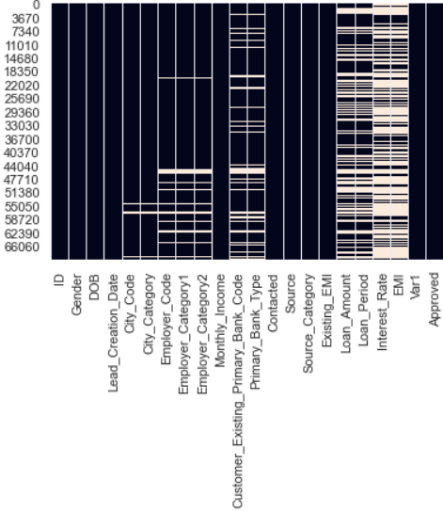
Missing values - KNN Imputer
There are 4 major attributes with large share of nulls. EMI and Interest_Rate with 68 % missing each, followed by Loan_Amount & Loan_Period with 40% each missing values.
Since, all the above mentioned attributes are significant contributors in Loan Prediction,quite coherent with Feature Importances seen later, we tried to impute them via Iterative Imputer using KNN.
Remaining attributes with nulls were Categorical in nature, which were dealt with by Mode Imputation basis Statistical tests.
Notes:
Nikhil

Slide 12
VIF and Feature Selection
Multicollinearity being an assumption for Logistic Regression, were dealt by iterating VIF scores and going with features with a score < 5.
For further filtering out among all the 39 features of the processed data, apart from VIF, we used the most widely used wrapper style selection algorithm i.e. RFE to select 20 top features as per the RFE ranking index.
The features selected via RFE were quite coherent with the Feature Importances of our intermediate model as well as with the selection basis SelectKBest method also, where we chose by interpreting the p-values of features using f_classif function as a scorer depicting the Anova scores of top 20 predictors.
Notes:
Nikhil

Slide 13
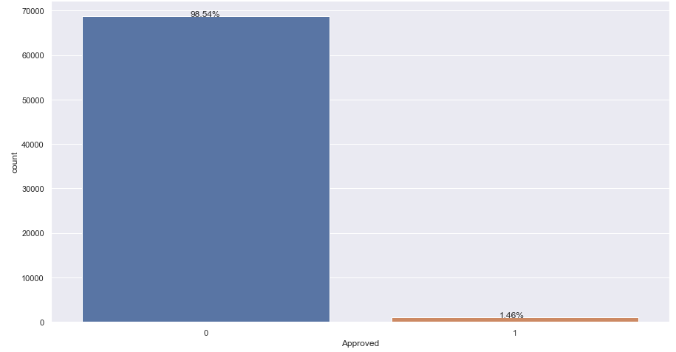
Data Preparation
Imbalanced Data :
Approval Data Proportion 98.5:1.5 percent.
Handling Imbalanced Data :
SMOTE - Synthetic Minority Oversampling Technique
Class Weight ‘balanced’
Notes:
Piyush
Q. Why did class weight balanced work better than SMOTE

Slide 14
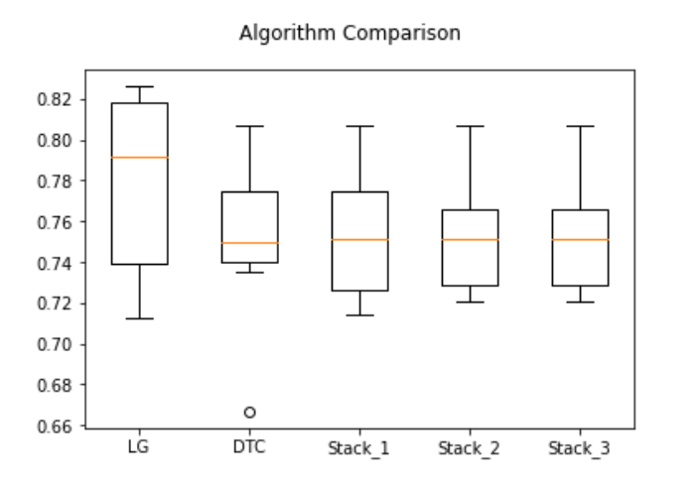
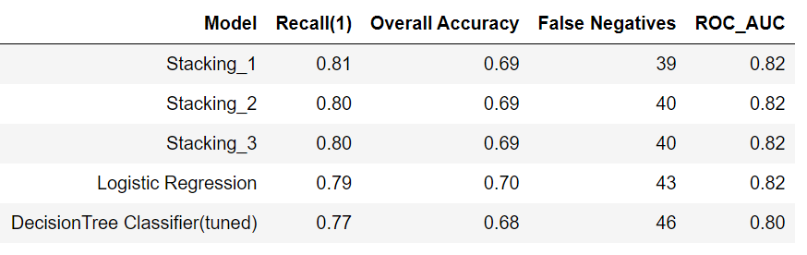
Modelling
Base : Logistic Regression
Intermediate : Decision Tree (Tuned)
Final : Stacking Classifier (Base Learners- Decision Tree, KNN Classifier and Gaussian Naive Bayes. Final Estimator- Logistic Regression.)
Notes:
Piyush
Q. Random Forest kyu nahi lagaya? - Hyperparameter tuning bohot time le raha tha vo bhi PC pe, DT achha result de raha tha toh kyu lagaye RF
Q. Bina 4 columns hataye model banaya?

Slide 15
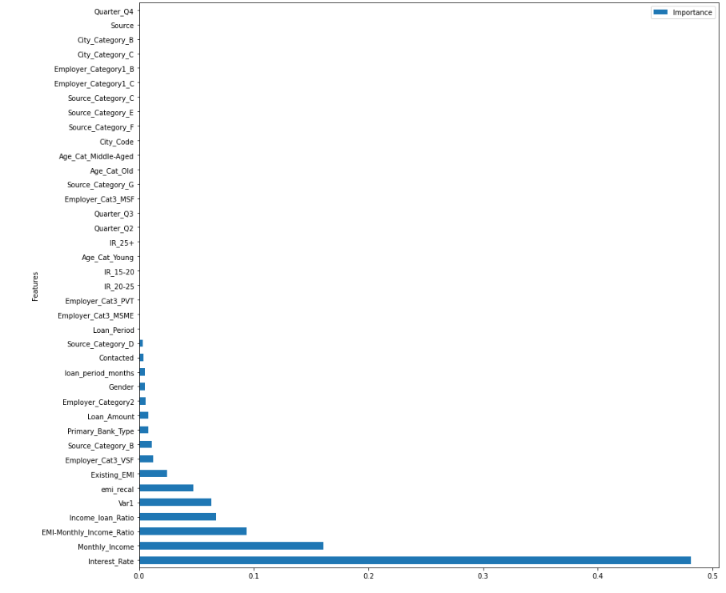
Model Comparison & Business Interpretation
Feature Importances :
Monthly income, employment status, city category, credit history, loan amount, type of loan and risks associated with it seem to be important aspects of lead conversion.
Notes:
Jise lage usse aur bolna hai

